Slide 1
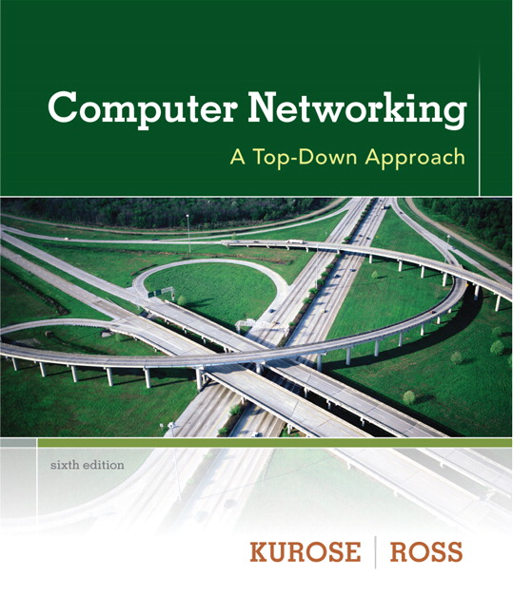
Chapter 4 Network Layer
Computer Networking: A Top Down Approach 6th edition Jim Kurose, Keith Ross Addison-Wesley March 2012
Course Name:
Computer Networks
Lecture by:
Dr. Moeenuddin Tariq

Slide 2
Chapter 4: network layer
chapter goals:
understand principles behind network layer services:
network layer service models
forwarding versus routing
how a router works
routing (path selection)
broadcast, multicast
instantiation, implementation in the Internet

Slide 3
Chapter 4: outline
4.1 introduction
4.2 virtual circuit and datagram networks
4.3 what’s inside a router
4.4 IP: Internet Protocol
datagram format
IPv4 addressing
ICMP
IPv6
4.5 routing algorithms
link state
distance vector
hierarchical routing
4.6 routing in the Internet
RIP
OSPF
BGP
4.7 broadcast and multicast routing

Slide 4
Network layer
transport segment from sending to receiving host
on sending side encapsulates segments into datagrams
on receiving side, delivers segments to transport layer
network layer protocols in every host, router
router examines header fields in all IP datagrams passing through it

Slide 5
Two key network-layer functions
forwarding: move packets from router’s input to appropriate router output
routing: determine route taken by packets from source to dest.
routing algorithms
analogy:
routing: process of planning trip from source to dest
forwarding: process of getting through single interchange

Slide 6
Interplay between routing and forwarding
routing algorithm
routing algorithm determines
end-end-path through network
local forwarding table
forwarding table determines
local forwarding at this router
header value
output link
0100
0101
0111
1001
3
2
2
1
value in arriving
packet’s header
0111
1
3
2

Slide 7
Connection setup
3rd important function in some network architectures:
ATM, frame relay, X.25
before datagrams flow, two end hosts and intervening routers establish virtual connection
routers get involved
network vs transport layer connection service:
network: between two hosts (may also involve intervening routers in case of VCs)
transport: between two processes

Slide 8
Network service model
Q: What service model for “channel” transporting datagrams from sender to receiver?
example services for individual datagrams:
guaranteed delivery
guaranteed delivery with less than 40 msec delay
example services for a flow of datagrams:
in-order datagram delivery
guaranteed minimum bandwidth to flow
restrictions on changes in inter-packet spacing

Slide 9
Network layer service models:
Network
Architecture
Internet
ATM
ATM
ATM
ATM
Service
Model
best effort
CBR
VBR
ABR
UBR
Guarantees ?
Congestion
feedback
no (inferred
via loss)
no
congestion
no
congestion
yes
no
Bandwidth
none
constant
rate
guaranteed
rate
guaranteed
minimum
none
Loss
no
yes
yes
no
no
Order
no
yes
yes
yes
yes
Timing
no
yes
yes
no
no

Slide 10
Chapter 4: outline
4.1 introduction
4.2 virtual circuit and datagram networks
4.3 what’s inside a router
4.4 IP: Internet Protocol
datagram format
IPv4 addressing
ICMP
IPv6
4.5 routing algorithms
link state
distance vector
hierarchical routing
4.6 routing in the Internet
RIP
OSPF
BGP
4.7 broadcast and multicast routing

Slide 11
Connection, connection-less service
datagram network provides network-layer connectionless service
virtual-circuit network provides network-layer connection service
analogous to TCP/UDP connecton-oriented / connectionless transport-layer services, but:
service: host-to-host
no choice: network provides one or the other
implementation: in network core

Slide 12
Virtual circuits
“source-to-dest path behaves much like telephone circuit”
performance-wise
network actions along source-to-dest path
call setup, teardown for each call before data can flow
each packet carries VC identifier (not destination host address)
every router on source-dest path maintains “state” for each passing connection
link, router resources (bandwidth, buffers) may be allocated to VC (dedicated resources = predictable service)

Slide 13
VC implementation
a VC consists of:
path from source to destination
VC numbers, one number for each link along path
entries in forwarding tables in routers along path
packet belonging to VC carries VC number (rather than dest address)
VC number can be changed on each link.
new VC number comes from forwarding table

Slide 14

VC forwarding table
12
22
32
1
3
2
VC number
forwarding table in
northwest router:
interface
number
Incoming interface Incoming VC # Outgoing interface Outgoing VC #
1 12 3 22
2 63 1 18
3 7 2 17
1 97 3 87
… … … …
VC routers maintain connection state information!

Slide 15

Virtual circuits: signaling protocols
used to setup, maintain teardown VC
used in ATM, frame-relay, X.25
not used in today’s Internet
application
transport
network
data link
physical
application
transport
network
data link
physical
5. data flow begins
6. receive data
4. call connected
3. accept call
1. initiate call
2. incoming call

Slide 16
Datagram networks
no call setup at network layer
routers: no state about end-to-end connections
no network-level concept of “connection”
packets forwarded using destination host address
application
transport
network
data link
physical
application
transport
network
data link
physical
1. send datagrams
2. receive datagrams

Slide 17
Datagram forwarding table
4 billion IP addresses, so rather than list individual destination address
list range of addresses
(aggregate table entries)
routing algorithm
local forwarding table
dest address
output link
address-range 1
address-range 2
address-range 3
address-range 4
3
2
2
1
IP destination address in
arriving packet’s header
1
3
2

Slide 18
Datagram forwarding table
Destination Address Range
11001000 00010111 00010000 00000000
through
11001000 00010111 00010111 11111111
11001000 00010111 00011000 00000000
through
11001000 00010111 00011000 11111111
11001000 00010111 00011001 00000000
through
11001000 00010111 00011111 11111111
otherwise
Link Interface
0
1
2
3
Q: but what happens if ranges don’t divide up so nicely?

Slide 19
Longest prefix matching
longest prefix matching
when looking for forwarding table entry for given destination address, use longest address prefix that matches destination address.
Destination Address Range
11001000 00010111 00010*** *********
11001000 00010111 00011000 *********
11001000 00010111 00011*** *********
otherwise
Link interface
0
1
2
3
examples:
DA: 11001000 00010111 00010110 10100001
which interface?
DA: 11001000 00010111 00011000 10101010
which interface?

Slide 20
Datagram or VC network: why?
Internet (datagram)
data exchange among computers
“elastic” service, no strict timing req.
many link types
different characteristics
uniform service difficult
“smart” end systems (computers)
can adapt, perform control, error recovery
simple inside network, complexity at “edge”
ATM (VC)
evolved from telephony
human conversation:
strict timing, reliability requirements
need for guaranteed service
“dumb” end systems
telephones
complexity inside network

